Slide 1




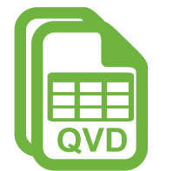

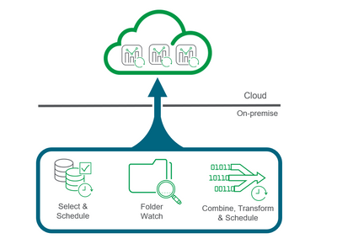

Data Architecture
Extract Data
Load
Data
Send Data to
Qlik Cloud
Data Analysis and Insights
FILES
Talend Data Integration
RDBMS
Talend Data Integration
Qlik Data Transfer
Qlik Cloud
Extract data from World Bank
Load data into Postgres database
Extract data from Postgres database and generate QVD files
Send QVD files to Qlik Cloud
Analyse data using Qlik Cloud

Slide 2
by Country and Year
%of access to Electricity
Extract data from World Bank
Load data into Postgres database
Extract data from Postgres database and generate QVD files
Send QVD files to Qlik Cloud
Analyse data using Qlik Cloud
Indicators
%of access to clean fuels and technology for cooking

